Slide 1
User Management
Simple User Management System for Practicing the IDesign Method using WCF Services
Covers:
  Login
  Change Password with New User Registration
  CRUD User operations
1

Slide 2
Requirements
Use Cases

Slide 3
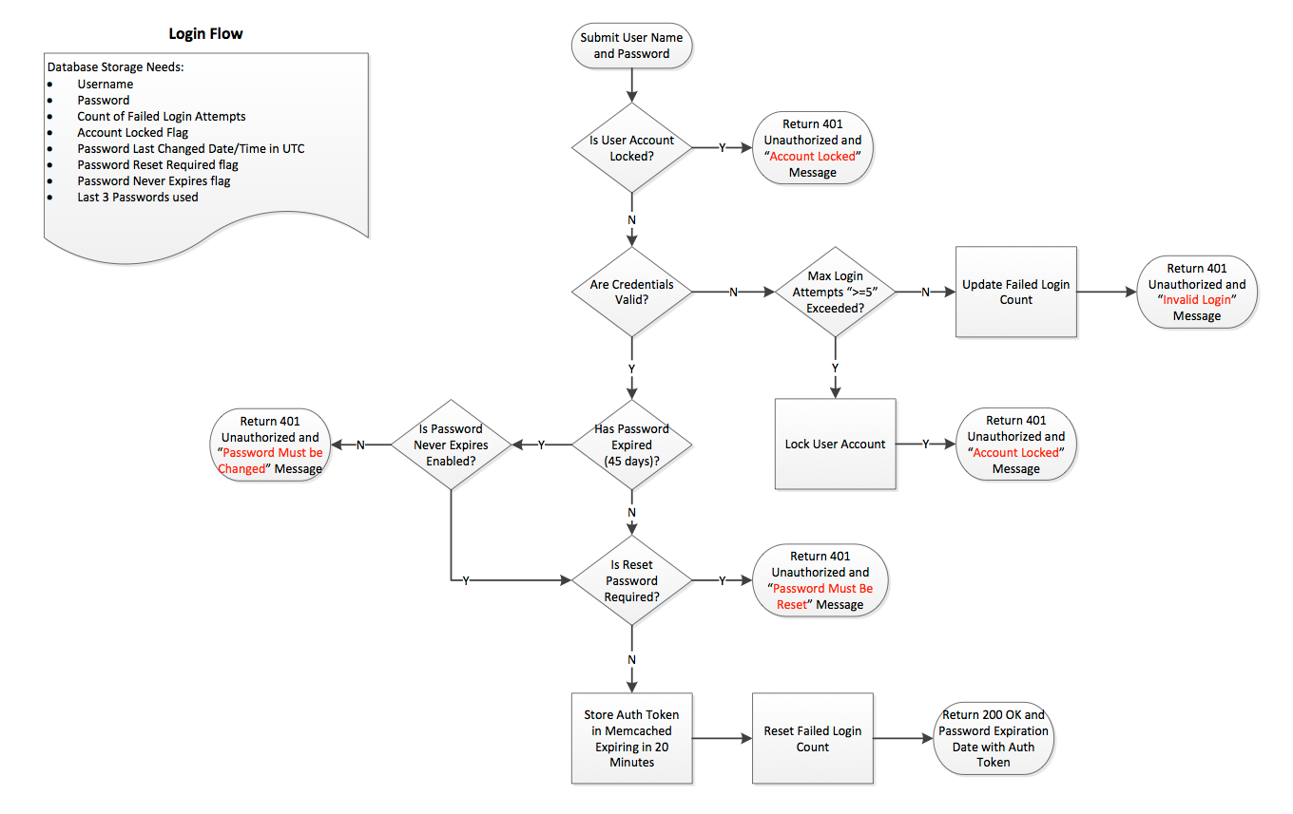

Slide 4
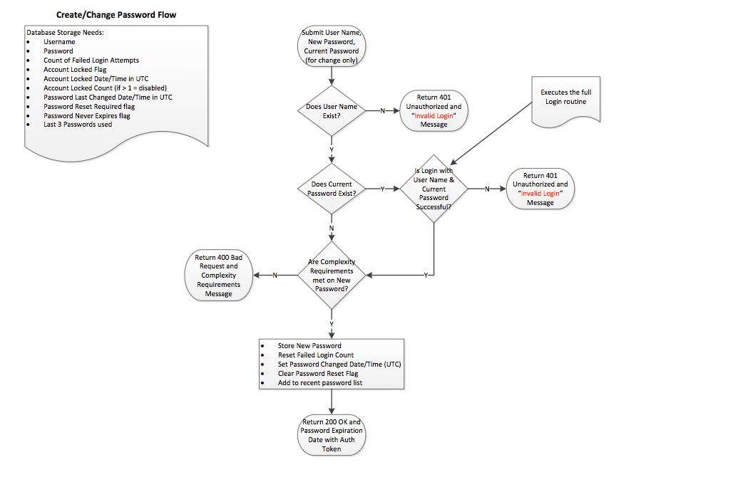

Slide 5
Architecture
Static Tiers View

Slide 6
Desktop
App
Client
User
Manager
Business
Logic
Authentication
Engine
Data
Access
User
Accessor
Data
User
Store

Slide 7
Call Chains

Slide 8
Desktop
App
Login/Change Password
Client
User
Manager
Business
Logic
Authentication
Engine
Data
Access
User
Accessor
Data
DB
Name

Slide 9
Desktop
App
CRUD User
Client
User
Manager
Business
Logic
Data
Access
User
Accessor
Data
DB
Name

Slide 10
Assemblies

Slide 11
Desktop
Application
Assembly (EXE)
User Manager
Assembly (DLL)
Authentication
Engine
Library
Assembly (DLL)
User Accessor
Library
Assembly (DLL)
Assemblies Allocation

Slide 12
WCF Services

Slide 13
User Manager
Assembly (DLL)
Authentication
Engine
Assembly (DLL)
User
Accessor
Assembly (DLL)
Services

Slide 14
Processes

Slide 15
Process Boundaries
Desktop
Application
Assembly (EXE)
User Manager
Assembly (DLL)
User Accessor
Assembly (DLL)
Authentication
Engine
Assembly (DLL)

Slide 16
Authentication

Slide 17
Desktop
App
CRUD User
Client
User
Manager
Business
Logic
Data
Access
User
Accessor
Data
DB
Name

Slide 18
Authorization

Slide 19
Desktop
App
CRUD User
Client
User
Manager
Business
Logic
Data
Access
User
Accessor
Data
DB
Name

Slide 20
Transactions

Slide 21
Desktop
App
Login/Change Password
Client
User
Manager
Business
Logic
Authentication
Engine
Data
Access
User
Accessor
Data
DB
Name

Slide 22
Desktop
App
CRUD User
Client
User
Manager
Business
Logic
Data
Access
User
Accessor
Data
DB
Name

Slide 23
Logical Threads

Slide 24
Desktop
App
Login/Change Password
Client
User
Manager
Business
Logic
Authentication
Engine
Data
Access
User
Accessor
Data
DB
Name

Slide 25
Desktop
App
CRUD User
Client
User
Manager
Business
Logic
Data
Access
User
Accessor
Data
DB
Name

